Slide 1
OIML Award for Excellent Contribution for Legal Metrology in Developing Country
Osama MELHEM
Notes:
1

Slide 2
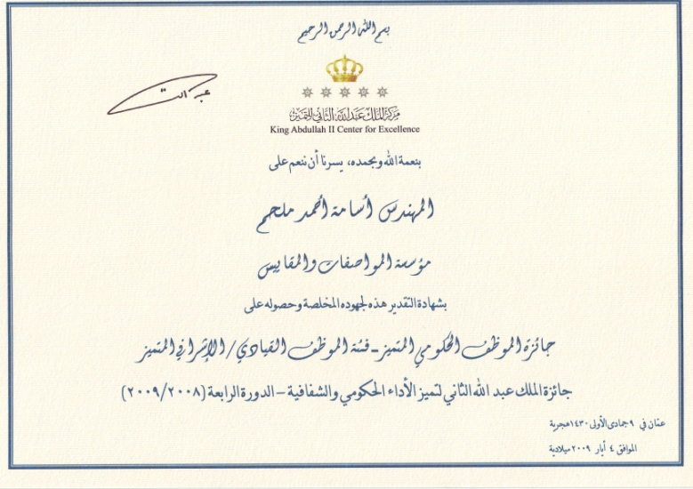
May 2009
King Abdullah II Award for Leadership Excellence

Slide 3
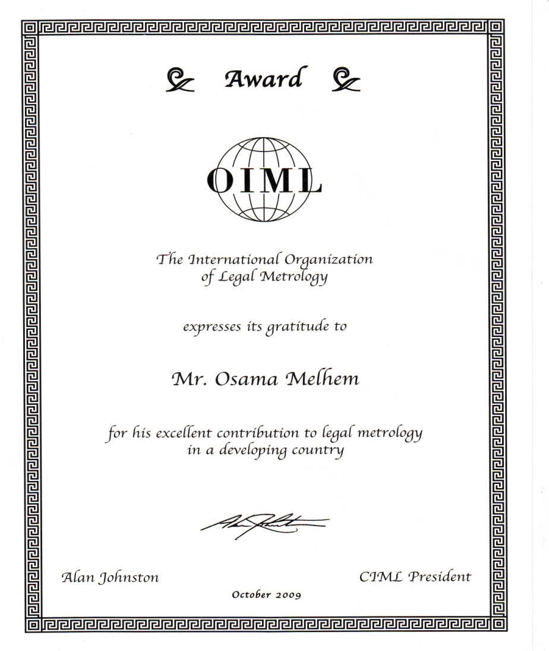
October 2009
OIML Award for Excellent Contribution for Legal Metrology in Developing Country

Slide 4
Working with the
Emirates Authority for Standardization and Metrology (ESMA)

Slide 5
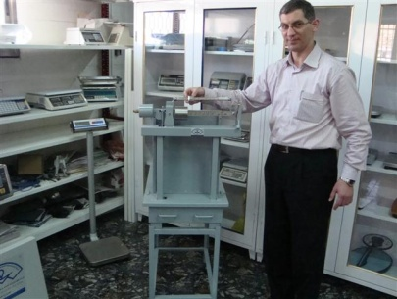
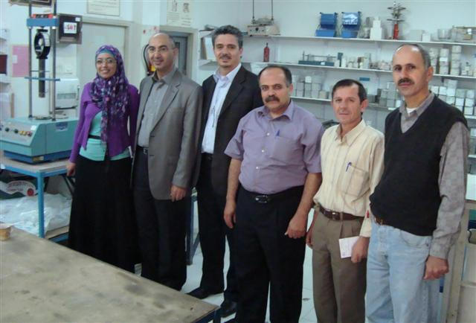
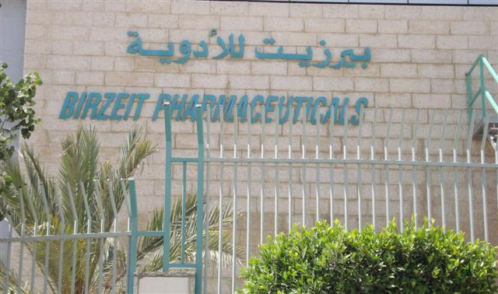
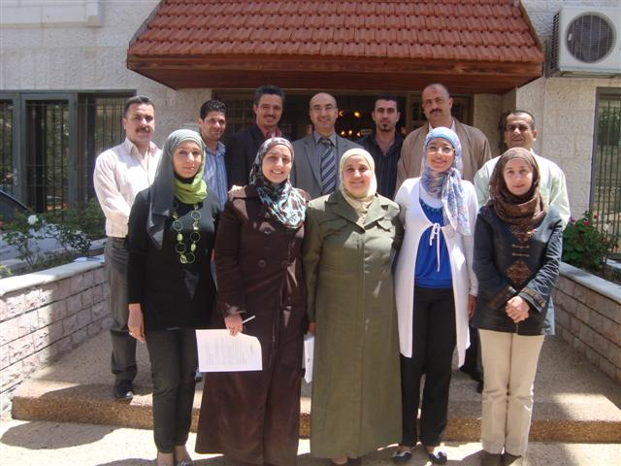
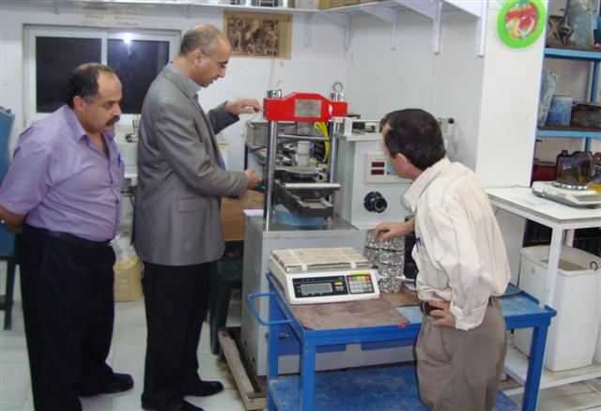
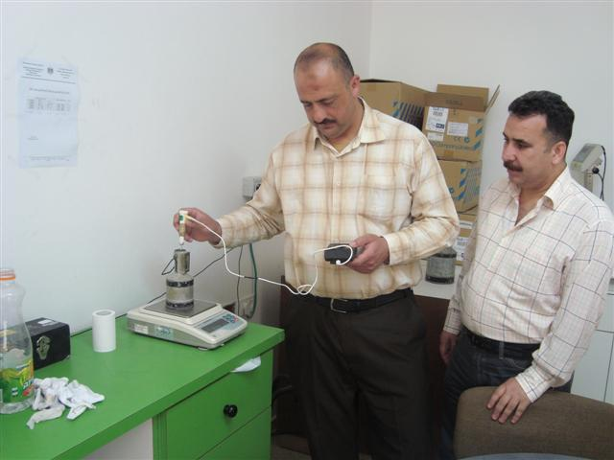
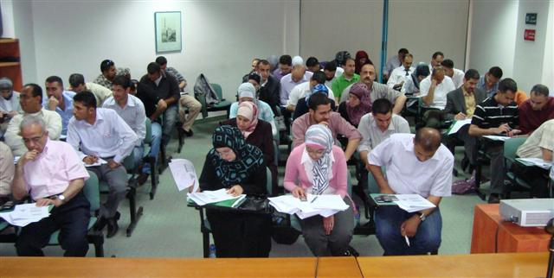
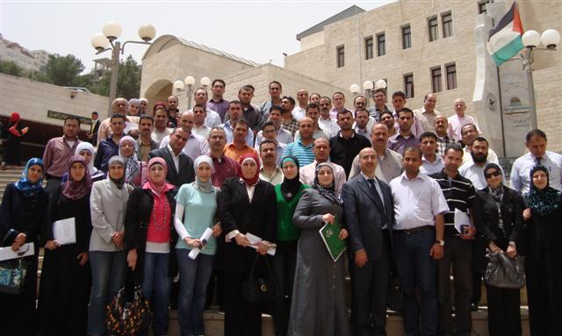
3-13 May, 2010
Palestinian Standards Institution (PSI)

Slide 6
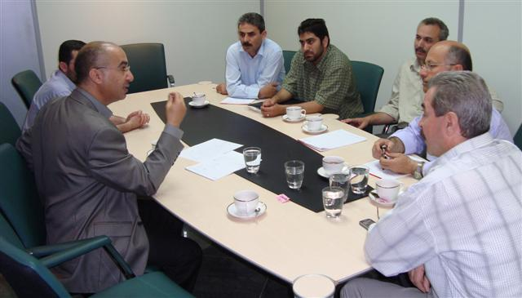
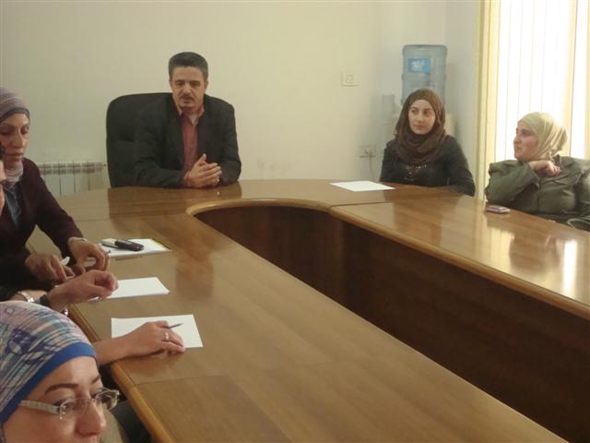
3-13 May, 2010
Palestinian Standards Institution (PSI)

Slide 7
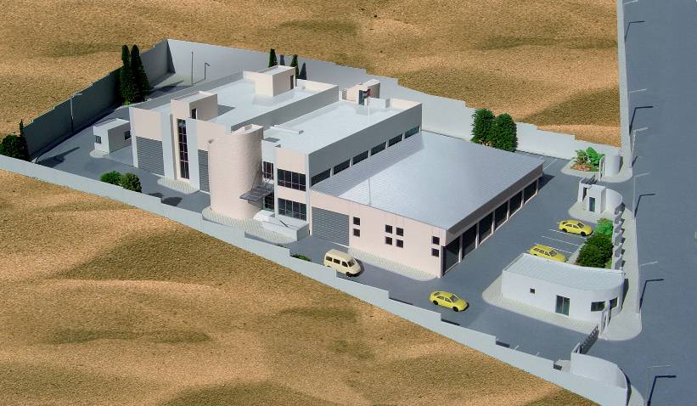
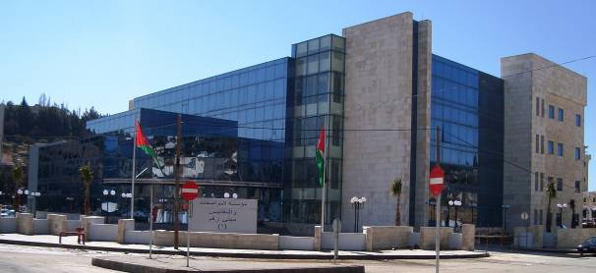
27-29 April 2010
High level delegate from the Weights & Measures Agency of Tanzania (WMA) visited Jordan to have a close look about the Jordanian metrology System

Slide 8
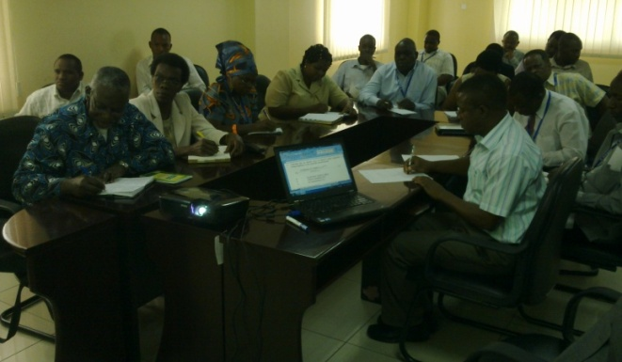
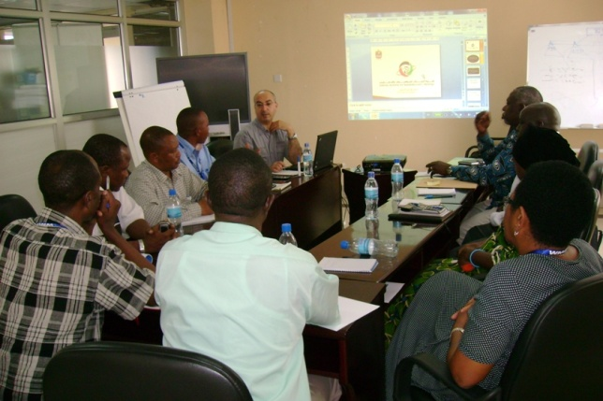
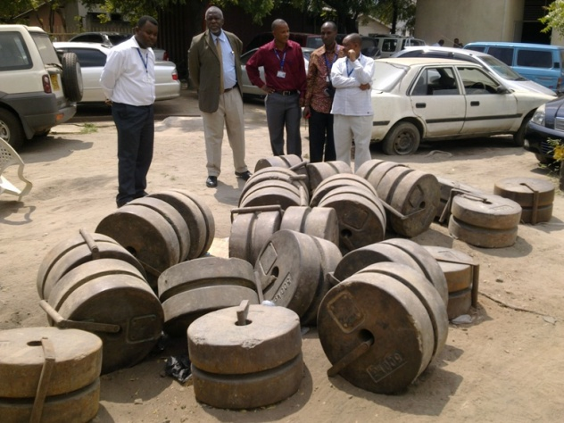
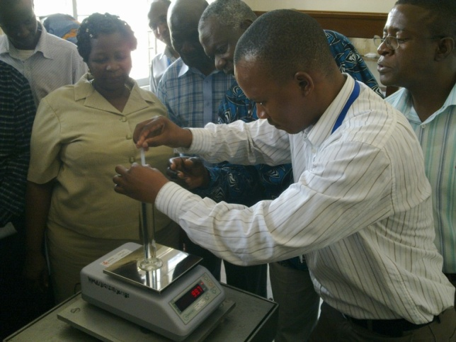
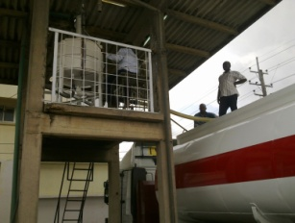
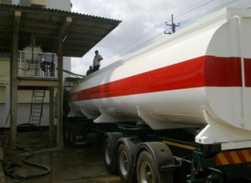
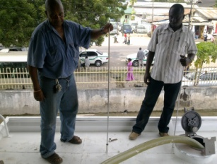
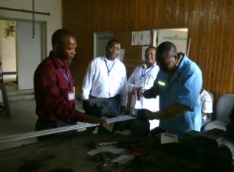
20-29 July 2011
Weights & Measures Agency of Tanzania (WMA)

Slide 9
What is the secret of success?

Slide 10
Thank you
Notes:
10

